Slide 1
IRENE-ENGLISH ACTIVITY

Slide 2
video
MOV_0002.mp4

Slide 3
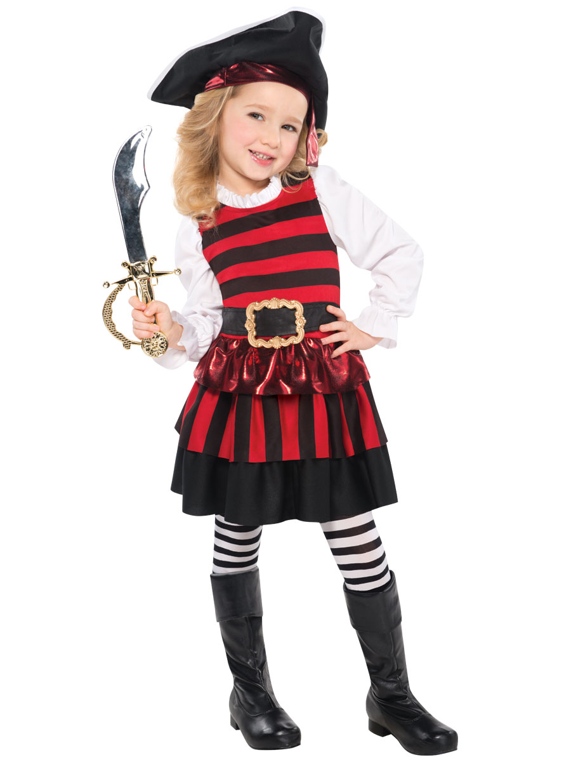
COSTUMEs

Slide 4
PIRATE CLOTHING

Slide 5
hook

Slide 6
EYE PATCH

Slide 7
Pirate cap

Slide 8
Sword

Slide 9
LET’S PLAY PIRATE GAME!!
Firstly,you will follow some rules in this game:
One person of the team stands up to spin the arrow. You will get an accessory without answer any question or you will get nothing if you get the white gap. You can turn the arrow only once.
The rest of the accesories you will have to answer the questions correctly, others accessories will be given for each correct answers.
Put the costume accessory on.One accessory for each player.
The team that gets more accessories of the pirate costume is the winner!!

Slide 10
QUESTION 1
Where is Katie Harrods Carrots from?
a.She is from England.
b.She is from Spain.
c.She is from Cardiff,Wales.

Slide 11
The answer is……
c.She is from Cardiff,Wales.

Slide 12
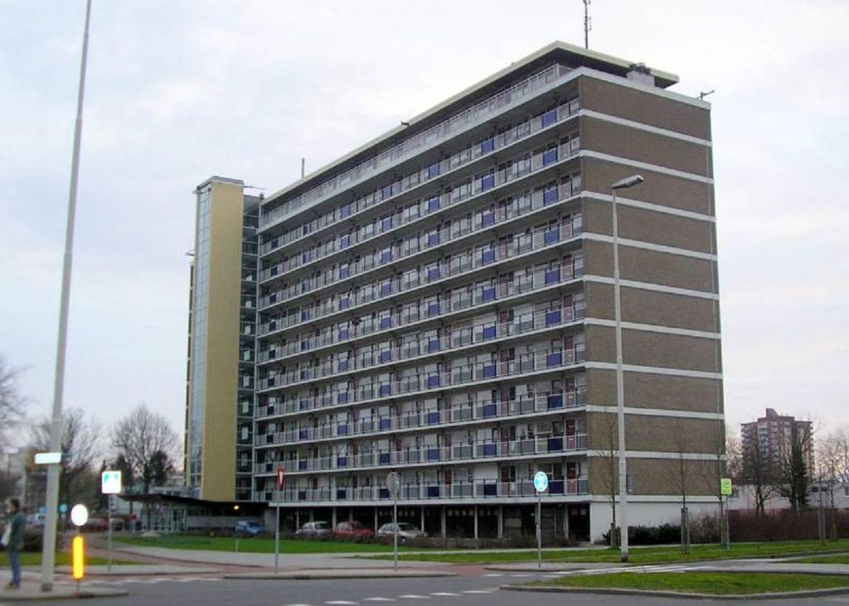
QUESTION 2
What is a flat?
A B
C

Slide 13
THE ANSWER IS…..

Slide 14
QUESTION 3
WHAT IS THE CORRECT SENTENCE?
a.Have got you any brothers or sisters?
b.Have you got any brothers or sisters?
c.Have you get brothers or sisters?

Slide 15
THE ANSWER IS….
b.Have you got any brothers or sisters?

Slide 16
Question 4
TRUE OR FALSE
Katie Harrods Carrots was reading a comic.

Slide 17
The answer is…..
TRUE!!!

Slide 18
QUESTION 5
ACTION-You will touch the wall!

Slide 19
QUESTION 6
ACTION-You will touch yellow color!!

Slide 20
QUESTION 7
ACTION-katie Harrods Carrots says play air guitar!!!

Slide 21
Question 8
Katie Harrods Carrots says……
TURN AROUND!!!

Slide 22
QUESTION 9
Katie Harrods Carrots says waddle like a penguin!!!!

Slide 23
QUESTION 10
Katie Harrods Carrots says cry like a baby!!!

Slide 24
QUESTION 11
How do you say”tengo hambre” in english?”
a.I am hungry.
b.I am thirsty.

Slide 25
THE ANSWER IS…..
B-I am hungry.

Slide 26
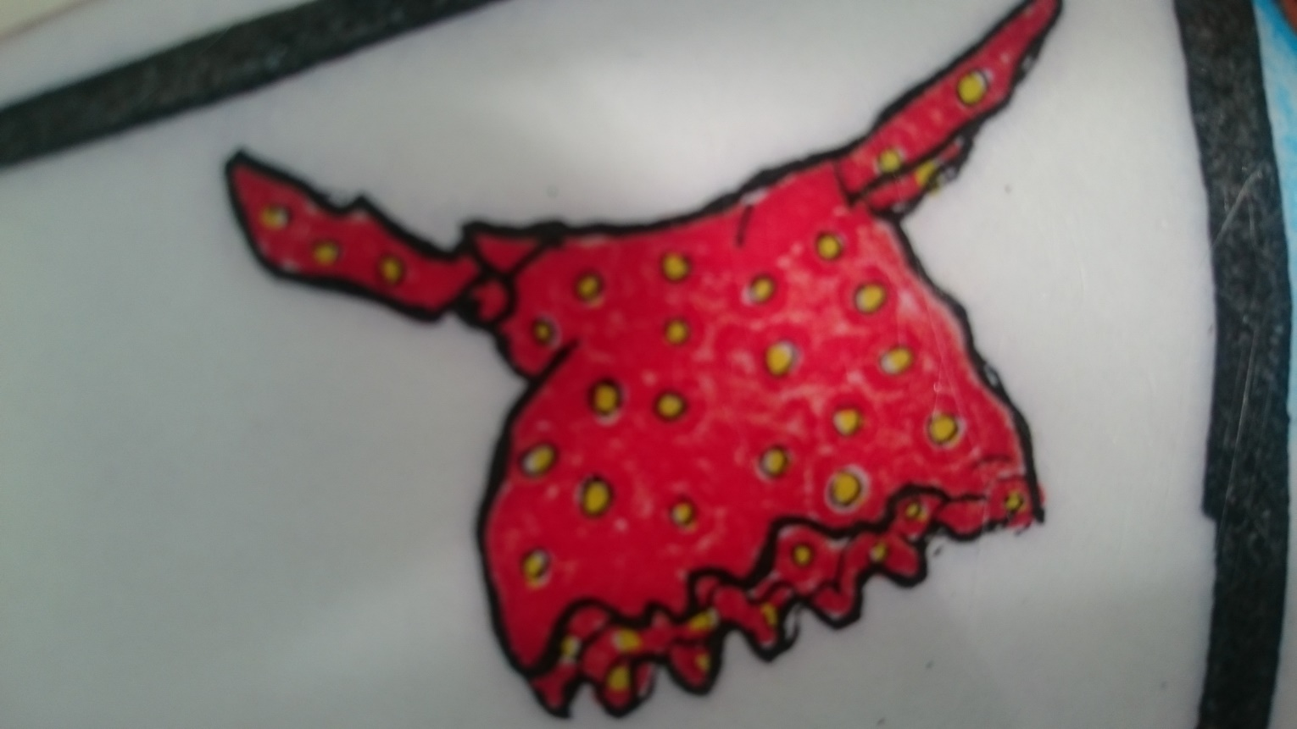
QUESTION 12
WHAT’S THAT?

Slide 27
Question 13
WHAT’S THAT?

Slide 28
QUESTION 14-WHAT’S THAT?

Slide 29
QUESTION 15-WHAT’S THAT?

Slide 30
QUESTION 16-WHAT’S THAT?

Slide 31
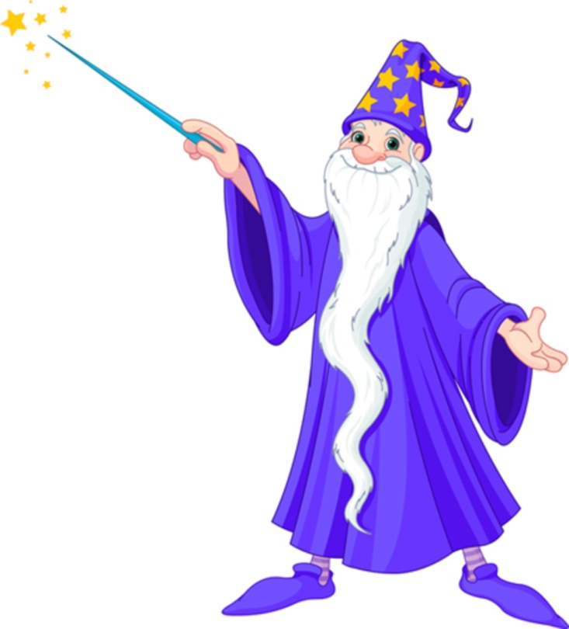
QUESTION 17-WHAT’S THAT?
A.WIZARD.
B-PRINCESS.
C-EXPLORER.

Slide 32
THE ANSWER IS….
a.WIZARD!!

Slide 33
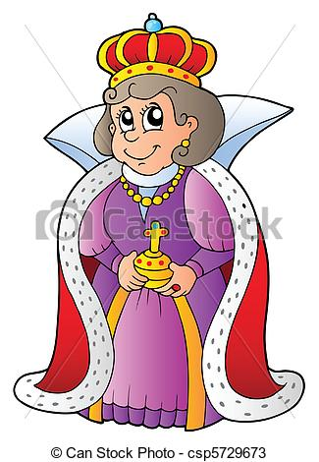
QUESTION 18-WHAT’S THAT?
A.SPY
B.KING
C.QUEEN

Slide 34
The answer is…
c.QUEEN

Slide 35
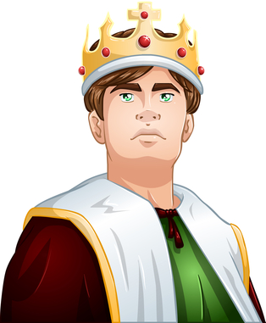
QUESTION 19-WHAT’S THAT?
A.QUEEN
B.PRINCE.
C.FOOTBALLER.

Slide 36
THE ANSWER IS…
b.PRINCE!!

Slide 37
QUESTION 21-WHAT’S THAT?
A.SPY.
B.EXPLORER.
C.FOOTBALLER.

Slide 38
THE ANSWER IS…
b.EXPLORER!!!

Slide 39
QUESTION 22-WHAT’S THAT?
A.KING
B.SPY
C.CAT.

Slide 40
THE ANSWER IS….
b.SPY

